Slide 1
MUNICIPAL PORT FUND OF ARISTOTLE
Let’s start with a million!
Ioannis G. Doulakis President of the Administrative Council
The presentation will last approximately 12 min and any questions are welcomed.

Slide 2
Our Ports

Slide 3
Introductory Elements

Slide 4
Introductory Elements
Revenues during the period 2015 - 2018
Coasting ticket taxes | € 805,186.67
Cruises boarding ticket taxes | € 29,672.59
Port taxes | € 87,256.96
Total | € 922,116.22

Slide 5
Introductory Elements
Comparative Revenue Graph

Slide 6
Dynamics of Port Activity

Slide 7
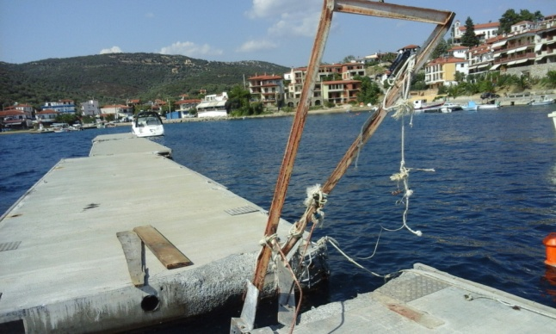
Dynamics of Port Activity
Revenues increase under unfavorable economic conditions during the period 2015-2018.
Facilities
Capital Controls
Bureaucratic obstacles

Slide 8
Dynamics of Port Activity
Power-Water Supply (€)
Concessions (€)
Taxes – Public Investment Program(ΠΔΕ) (€)

Slide 9
Dynamics of Port Activity
Development potential of port activities.
Increase in passenger seats
Demand for berths
Demand for Marinas
Demand for Water Airports

Slide 10
Dynamics of Port Activity
Lack of port facilities.
Unexploited comparative advantages that have the potential to boost the creation and development of new port facilities.

Slide 11
Comparative Advantages of the Municipal Port Fund of Aristotle

Slide 12
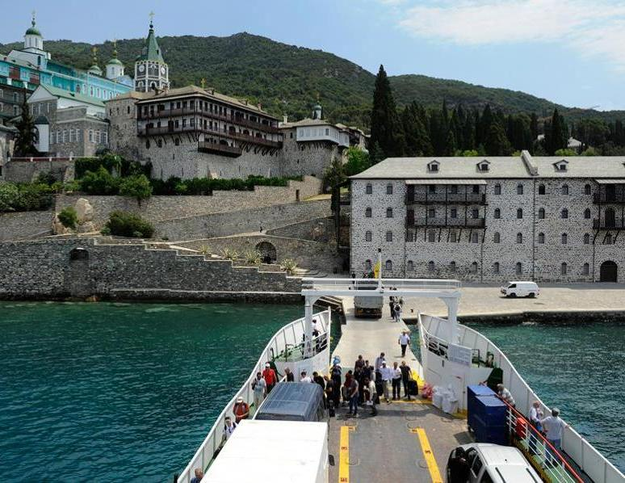
Municipal Port Fund of Aristotle Comparative Advantages
Mount Athos

Slide 13
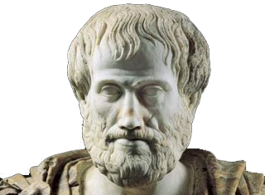
Municipal Port Fund of Aristotle Comparative Advantages
Ancient Stagira The birth place of Aristotle

Slide 14
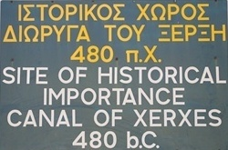
Municipal Port Fund of Aristotle Comparative Advantages
Xerxes Canal

Slide 15
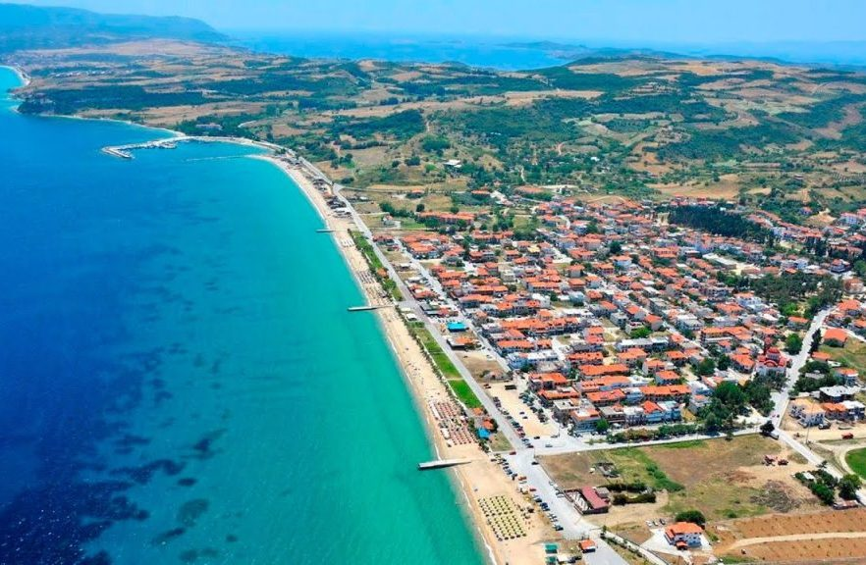
Municipal Port Fund of Aristotle Comparative Advantages
Ammouliani Island
Ierissos

Slide 16
Municipal Port Fund of Aristotle Comparative Advantages
Various tourist facilities in the local area.
67 Hotels (3 five Star)
3.894 Rooms
7.609 Beds
No existence of a touristic Port/marina in the area!
327 Rental rooms
2.300 Rooms
4.600 Beds

Slide 17
Our Vision

Slide 18
Our Vision
Prediction: € 25,000,000 of investments in local economy by 2029!
Economic Cluster:
Touristic Enterprises
Shipbuilding Enterprises
Other Sector (s)
Municipal Port Fund of Aristotle
(Port Investments)
Shipping Enterprises
Construction Enterprises

Slide 19
Our Vision
Five years/decade targeting

Slide 20
Our Vision
Eventually, in our country, planning port works may not be a chimaira but a springboard to the developmental ejection of the economy, a realistic target and finally a self-evident way to a healthy and sustainable regional development.

Slide 21
Thanks for your attention !
Ioannis G. Doulakis President of the Administrative Council

